Slide 1
1 - Planning your
interdisciplinary research project
Dawn McArthur, PhD
Director, Research & Technology Development

Slide 2
Webinar #1
Webinar #2
TEAM
PROJECT
PROPOSAL

Slide 3
Webinar #1 - Outline
TEAM
PROJECT
Seed Grant Program
Interdisciplinary research
Teams and partnerships
Developing a project for this RFA

Slide 4
Seed Grant Program Goal
to enable researchers and knowledge users at UNBC, NH, and PHSA to work in partnership
and
to initiate new research projects that focus on improving the quality of health services and improving population health in northern BC

Slide 5
Seed Grant Program Goal
The RFA requires
Northern/Rural/Remote Health Focus
Must address a health challenge identified in northern BC
Community Involvement
Preference will be given to applications that include community, patients and/or clinical collaborators

Slide 6
Interdisciplinary research
“research that transcends conventional academic boundaries”
NSERC defines interdisciplinary research as
"research that involves the interaction
among two or more different disciplines"
occurs at the interface between disciplines
ranges from sharing of ideas to integration of concepts, methodology, procedures, theory, terminology, data, organization of research and training

Slide 7
What does interdisciplinary mean?
Uni-disciplinary
Multi-disciplinary
Inter-disciplinary
Project
Project
Project
Single
output
Set of
outputs
Integrated
output

Slide 8
TEAM

Slide 9
Build the team
What the RFA requires
A new research team (3 or more applicants) led in partnership by individuals from UNBC, NH and PHSA
Co-Principal Investigators
Nominated Co-PI must hold an academic appointment at UNBC and be eligible to hold research funding
One Co-PI must be primarily affiliated with NH
One Co-PI must be primarily affiliated with PHSA

Slide 10
Build the team
What the RFA requires
The proposal must include
an outline of team structure
description of contribution of each member to the research activity/plan
It must describe
how the team will collaborate in relation to
project methodology, ethical considerations
data collection, analysis and interpretations
key messaging and recommendations

Slide 11
Build the team
Get consensus on
Composition – expertise, experience, skills, roles
Collaboration – leadership, decision-making
Commitment – time, resources, management
Communication – why, how, when

Slide 12
Build the team
Tuckman’s model of team effectiveness
Forming team has poor consensus;
members acting as individuals
Storming team has some conflicts as individuals adapt to teamwork
Norming team has consensus, clarity of roles;
functions as a collective
Performing team has shared vision, strategy; functions as a cohesive unit
new
teams
Tuckman, Bruce W. Developmental sequence in small groups. Psychological Bulletin, Vol 63(6), Jun 1965, 384-399.

Slide 13
Build the team
Some considerations for new teams
Do team members know one another?
What is the discipline of each team member?
How many disciplines are represented?
What research/project experience does each have?
What skills/expertise does each bring?
How does each prefer to work?
How much flexibility does each have?

Slide 14
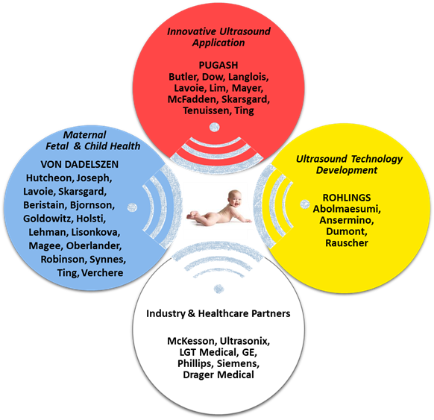
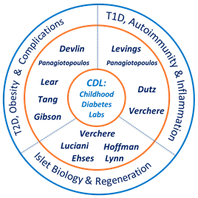
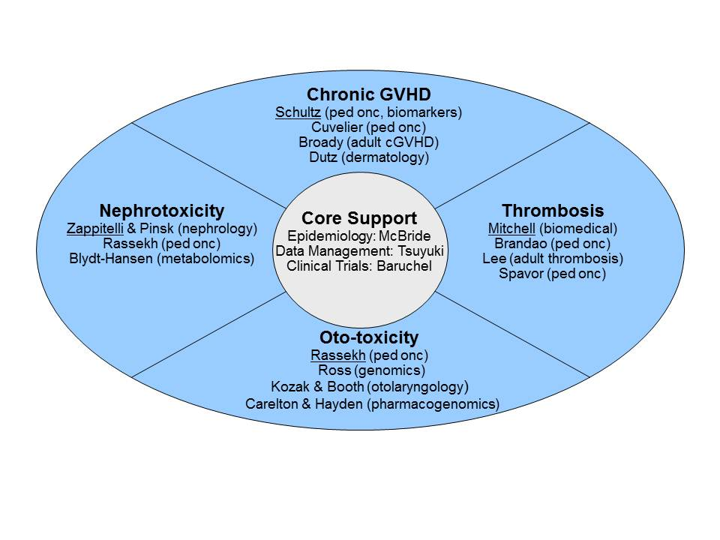
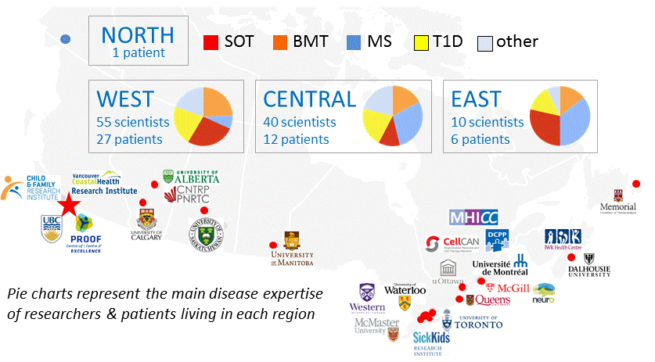
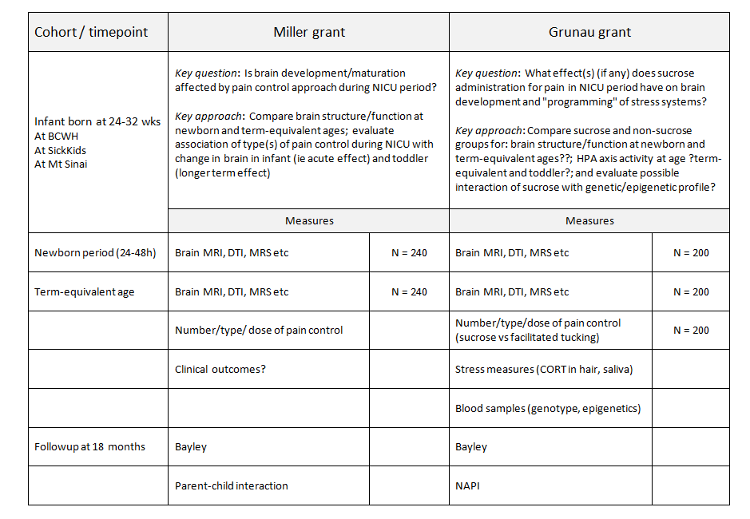
Team structure schematics

Slide 15
PROJECT

Slide 16
Develop your project
What the RFA requires
UNBC, NH, PHSA collaboration
Northern/rural/remote health focus
Community involvement (preferred)
Must describe how the research project will be carried out to meet project objectives

Slide 17
Develop your project
Team members discuss
health issue / priority
study scope
research question(s)
study design
data collection, analysis, interpretation
team member contributions/expectations
community collaborations

Slide 18
Develop your project
Research context, knowledge gaps
KT
Researchersparticipants, partners
Research question
KT
Plan: objectives, approaches & methods
settings
groups
tools
data
collection
data
analysis
Expected findings
Impact

Slide 19
Develop your project
Get consensus on
Project needs – knowledge, skills, partners, resources
Project plan – logistics, timeline, budget
Team work – roles / responsibilities, management
Outcomes – “ownership”, expectations, next steps

Slide 20
Develop your project
Budget = research activities + resources
Personnel (staff, students, fellows)
Materials (supplies, consumables)
Services (external costs)
Travel (research, conference)
Other Costs
Dissemination/Knowledge translation
Partner contributions (cash, in-kind)
See RFA for eligible/ineligible costs

Slide 21
Develop your project
Letters - collaboration, support, partnership
ASK EARLY!! At least 1 month before deadline
Make sure they understand the issues the letter should address
Make it easy – provide a draft letter (may also provide a copy of draft proposal)

Slide 22
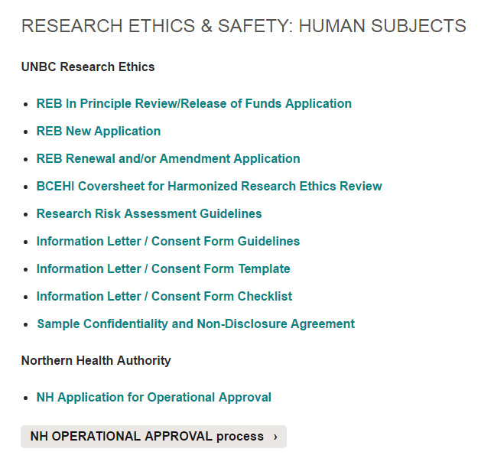
Develop your project
Remember
Ethics requirements
OCAP requirements
OCAP® is a registered trademark of the
First Nations Information Governance Centre (FNIGC)
http://fnigc.ca/ocap.html

Slide 23
Thanks very much.
Any questions?

