Slide 1
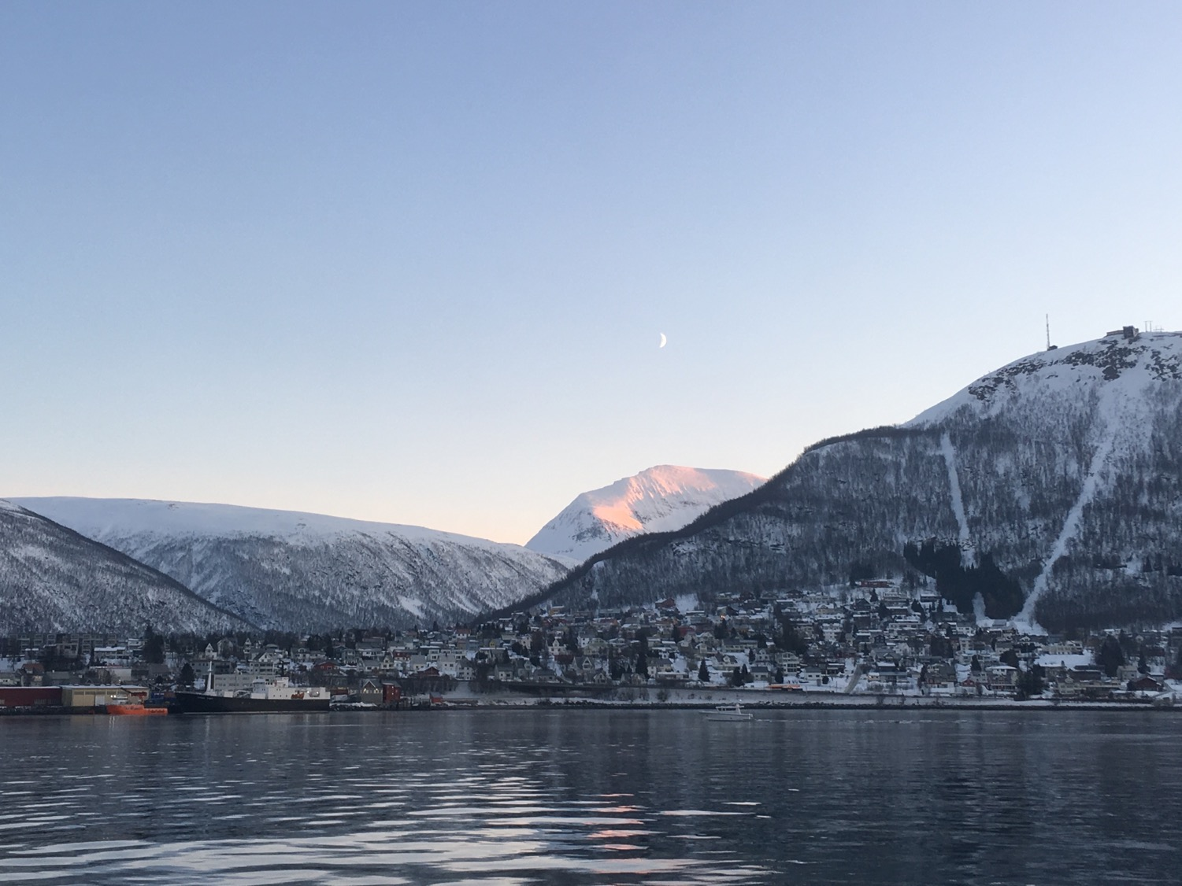
NORTHERN RESEARCH AT UNBC
NORS (NORTHERN STUDIES @ UNBC)
UNBC RESEARCH WEEK 2022

Slide 2
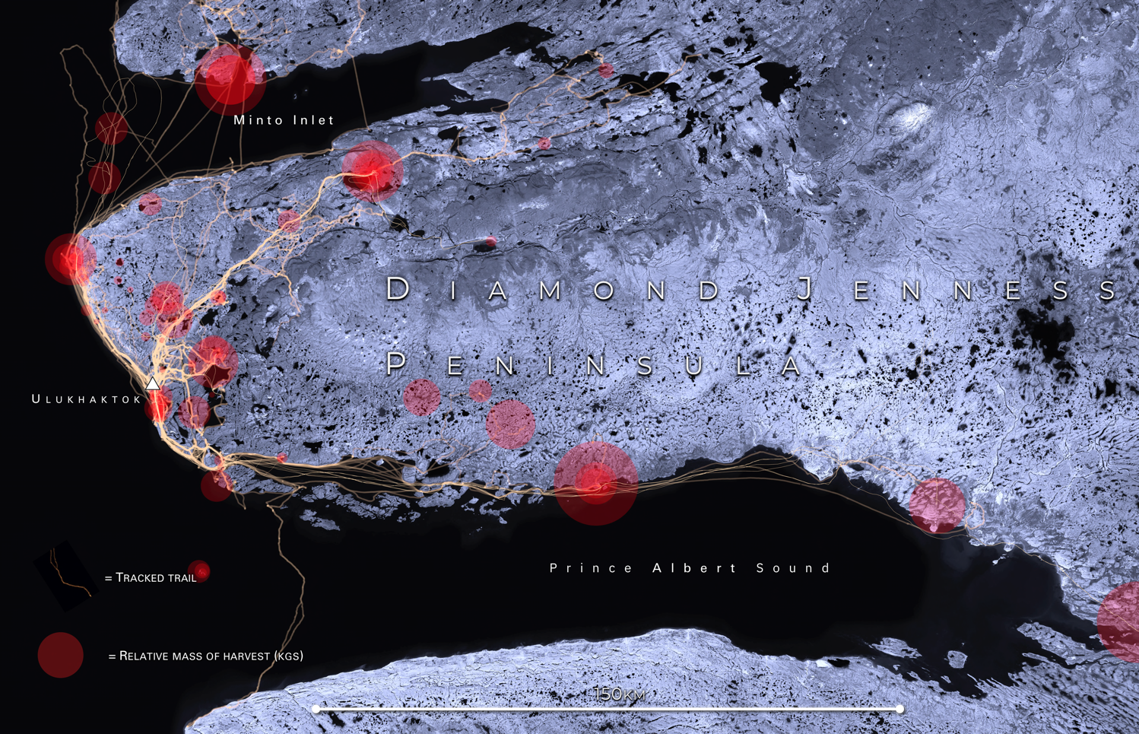
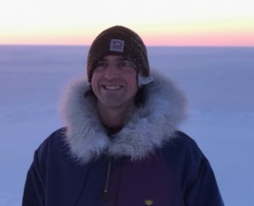
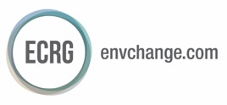
Real-Time Monitoring of Environmental Risks and Inuit Hunting in the Arctic
Dr. Tristan Pearce

Slide 3
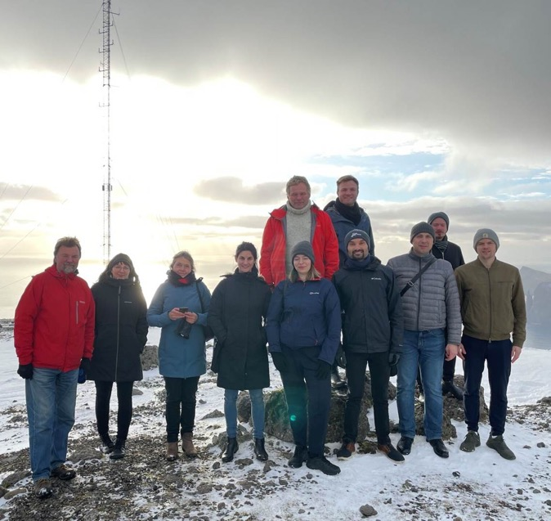
Dr. Paul Bowles
(Global and International Studies, Economics)
ARCTIC ACADEMY FOR SUSTAINABILITY
The new ‘Arctic Academy for Sustainability’, (under Uarctic) will run from 2022-2025, with four intensive meetings/ field trips. Faculty, PDFs, graduate students and local stakeholders will exchange information and develop new insights for Arctic sustainability.
Project Lead Dr. K. Buhmann explains: “Designed to investigate one of the most pressing issues in the world today, the Academy will focus on pathways to a socially just green transition which will benefit Arctic communities, public and private stakeholders, and the planet as a whole.” Dr. Paul Bowles notes: “UNBC will host the Academy in May 2023, offering graduate students a great learning environment, with scholars and students from around the world. It will also be an opportunity for UNBC students to tell others about our region”.
Partners: Copenhagen Business School, Universities of Helsinki, Tyumen and Northern British Columbia
Funding: Prince Albert of Monaco II Foundation

Slide 4
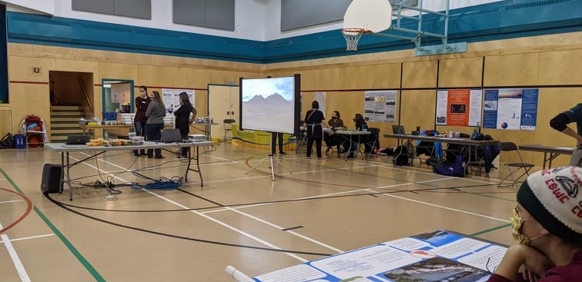
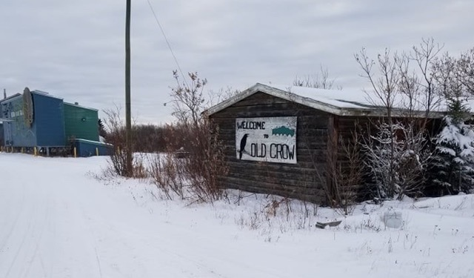
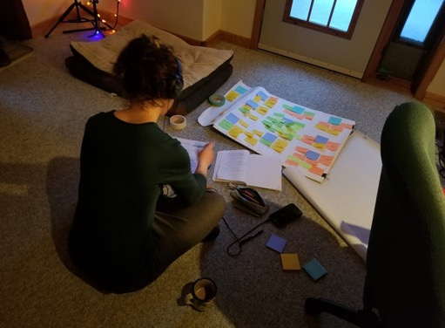
Aven Knutson
(MA NRES Student)
PROCEDURAL JUSTICE AND
SELF-DETERMINATION IN A YUKON
CLIMATE PLANNING PARTNERSHIP
My thesis documents a recent collaborative climate planning process between Government of Yukon and Indigenous partners to examine how the process meets standards of procedural justice and Indigenous self-determination that are a necessary part of Indigenous planning practices. The engagement between Government of Yukon and Indigenous partners is one of the first models of this type of shared decision-making in climate planning. I aim to understand the process’ usefulness and to develop recommendations for future climate/environmental planning partnerships between colonial governments and northern communities.

Slide 5
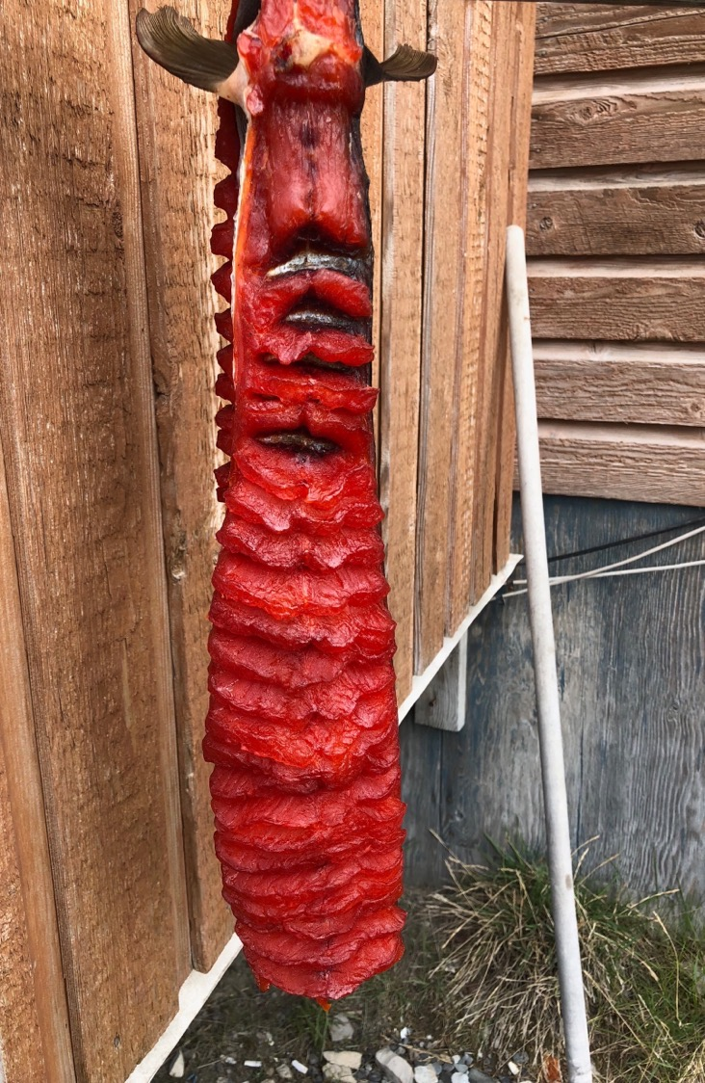
Knowledge Co-Production of Arctic Char (Salvelinus alpinus) in the Arctic
Dr. Tristan Pearce
Pamialok (Jerry Sr. Akoaksion), Ulukhaktok, NT

Slide 6
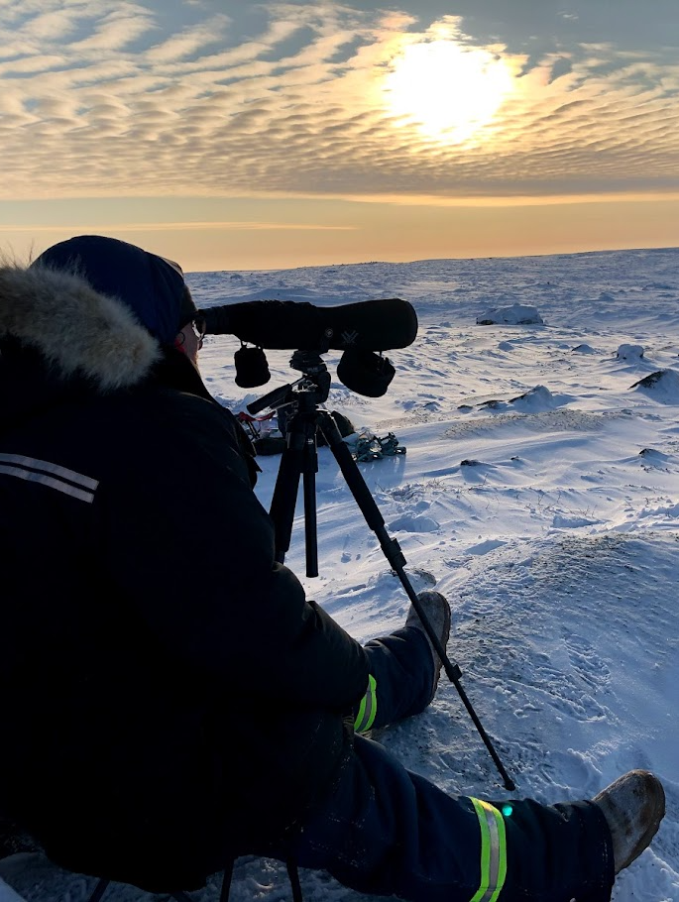
Dr. Chris Johnson, Angus Smith
(Ecosystems Science & Management; MSc NRES student)
WHY DID THE CARIBOU CROSS THE ROAD? BARREN-GROUND CARIBOU AND AN INDUSTRIAL WINTER ROAD IN THE NORTHWEST TERRITORIES
The Tibbitt to Contwoyto winter road is the primary route of supply for diamond mines in the central Northwest Territories. The road and the associated mines overlap with the range of several herds of barren-ground caribou. We investigated how the winter road influenced the behaviour, stress, and road crossing events of caribou. Our results show that caribou change their behaviour near the winter road, spending less time feeding and more time walking. Also, we found that very few caribou crossed the road when confronted with normal levels of industrial traffic.
NRES graduate student, Angus Smith, trying to stay warm while observing the behaviour of caribou.

Slide 7
NORTHERN RESEARCH AT UNBC
CIRUCMPOLAR
NATURAL SCIENCE
INDIGENOUS
ARCTIC
HUMANITIES
INTERNATIONAL
NORTHERN STUDIES
SOCIAL SCIENCE
INTERDISCIPLINARY

Slide 8
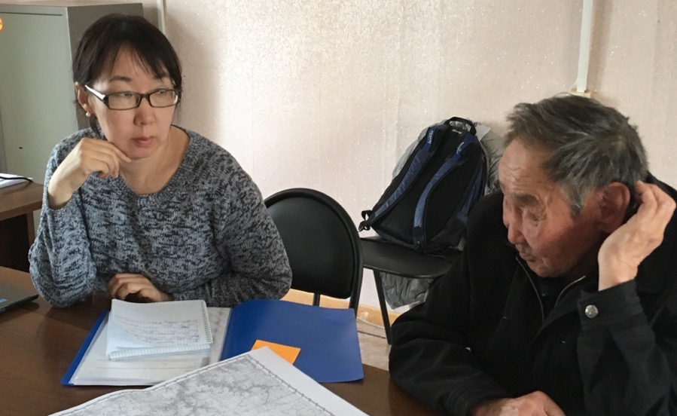
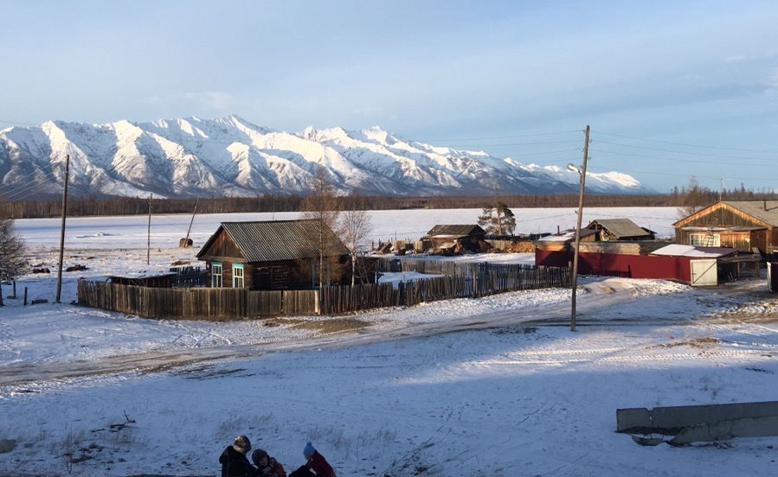
Dr. Gail Fondahl (PI)
(Geography, Earth & Environmental Sciences)
﻿
INDIGENOUS TERRITORIAL RIGHTS IN THE RUSSIAN FEDERATION:
A QUARTER CENTURY ONWARD
A suite of legal acts at both the federal and sub-federal level guide Indigenous rights to land and resources in Russia. Who has input into the drafting of these laws? How are they invoked, interpreted and implemented? And how are they evaluated by those Indigenous persons who seek to use them? Our research seeks to answer these questions, with attention to differences across space.

Slide 9
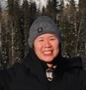
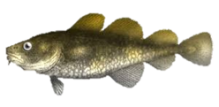
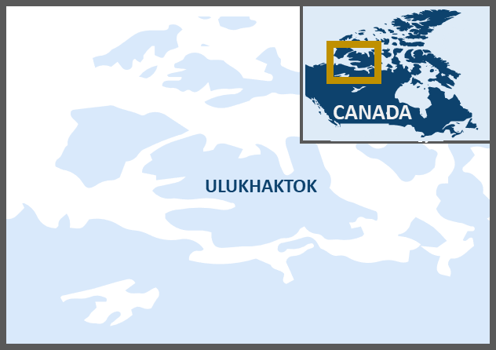
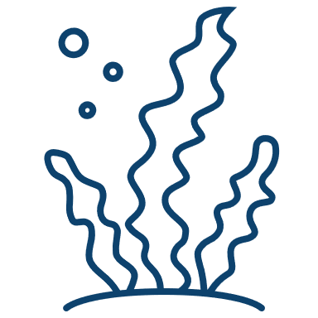
ARCTIC MARINE ECOSYSTEMS
Stephanie Chan
MSc NRES
schan@unbc.ca
Why?
GREENLAND COD (GADUS OGAC)
LIMITED KNOWLEDGE ON COASTAL MARINE ECOSYSTEMS
serves as an indicator for environmental change.
Study of fish shape
Master’s thesis
Study of feeding behavior
CHANGES IN ABUNDANCE AND SIZE
of fish have been reported by Inuit in the western Canadian Arctic.
This research will improve our understanding of coastal marine species that Inuit depend on for subsistence.
FISHERIES CO-MANAGEMENT
bodies in the western Canadian Arctic can be informed to ensure decision making is done with the most up-to-date knowledge.
ArcticNet Project Number 33: Using Co-Produced Knowledge to Understand and Manage Subsistence Marine Harvests in a Changing Climate

Slide 10
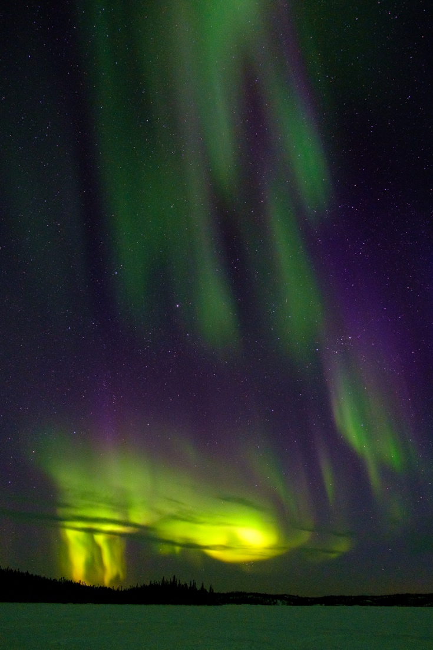
Dr. Fiona MacPhail
(Global and International Studies, Economics; with Aja Mason, Yukon Status of Women Council)
COVID-19 IMPACTS ON THE LIVELIHOODS AND WELL-BEING OF WOMEN IN THE YUKON: TOWARD A RESILIENT AND INCLUSIVE RECOVERY
Emerging research demonstrates that economic impacts of the COVID-19 pandemic are gendered and that women disproportionately experience adverse effects, although the specific impacts vary among women and across locations. We aim to understand how and why the COVID-19 pandemic has impacted the livelihoods and well-being of women in the Yukon, and how policies and programs can promote a resilient and inclusive recovery in the territory. We will investigate three main hypotheses in the Yukon: the nature of the she-cession, care penalty and shadow pandemic. The project is funded by the Government of Yukon and the co-leads of the project value the opportunity to work with seven non-government Yukon organizations who are research partners on the project.
Source: Marie-Soleil Desautels, Globe and Mail, 11.02.2022

Slide 11
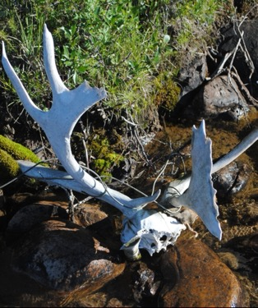
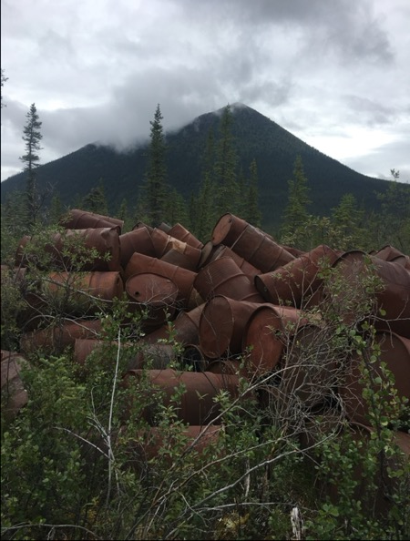
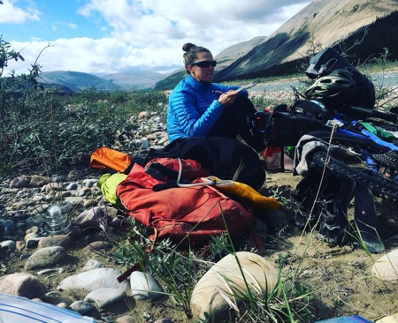
This research examines the lasting impact of energy infrastructure in the Canadian North, exploring settler colonialism and environmental justice as key themes. The Canol Pipeline and Shutagot’ine Trail Remediation Project serve as an example of abandoned, remediated, and repurposed industrial landscapes. They provide an opportunity to critically examine colonial-capitalist resource extraction and to support Indigenous-led social and ecological healing in an era of unprecedented transformation for Sahtu lands and people.
Dr. Sinead Early
(Sustainability Studies)
Energy Infrastructure and Colonial Geographies in the Canadian North:
The Canol Pipeline and Shutagot'ine Trail Remediation Project

Slide 12
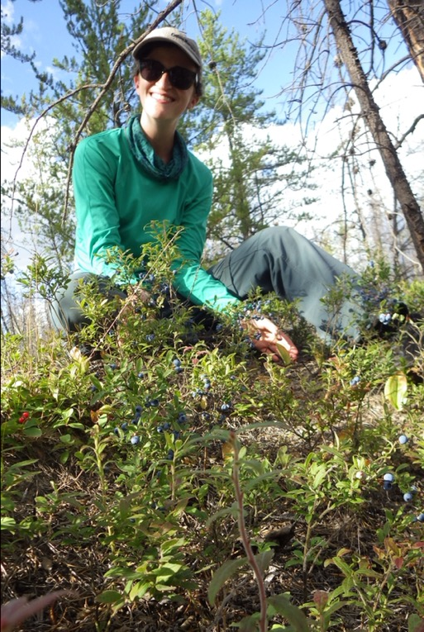
Dr. Tara Joly
(Anthropology)
GENDERED VIOLENCE AND NORTHERN EXTRACTIVE ZONES
Researchers in data collection settings often experience gendered sexual violence , and higher rates of gendered violence is often reported in northern extractive zones among the general population. This research seeks to understand the conditions of northern extractive zones that reproduce sexual violence among ethnographers. It aims to support gendered violence prevention at individual and institutional levels.
Three interrelated ‘cultural’ assumptions about anthropological fieldwork may perpetuate harm: First, a need to ‘go it alone’ or conduct research in an isolated setting; second, affinity with your participants, or a requirement to “love” the people you work with; and finally, pressure to suffer for your research/gather data at all costs.

Slide 13
NORTHERN RESEARCH AT UNBC
NORS (NORTHERN STUDIES @ UNBC)
UNBC RESEARCH WEEK 2022

Slide 14
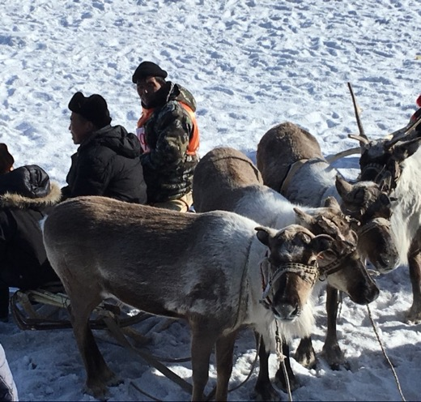
Dr. Gail Fondahl
(Geography, Earth & Environmental Sciences)
INDIGENOUS PEOPLES’ RIGHTS FRAMEWORKS AND THE (RE)DISTRIBUTION OF MINING WEALTH IN THE ARCTIC:
A COMPARATIVE ANALYSIS
While mining in the Arctic generates economic benefits, significant disparities exist in the distribution of mining wealth at the global, national, and regional levels. This project examines the varied legal frameworks across Arctic jurisdictions for Indigenous communities to benefit from the mining wealth extracted from their traditional territories, and aims to propose institutional and legal changes to foster a more equitable distribution of mining wealth to Indigenous communities in the Arctic.
(Project Lead: Dr. Sophie Theriault, U Ottawa; Partnership Lead: Dr. Gerard Duhaime, Laval U.)

Slide 15
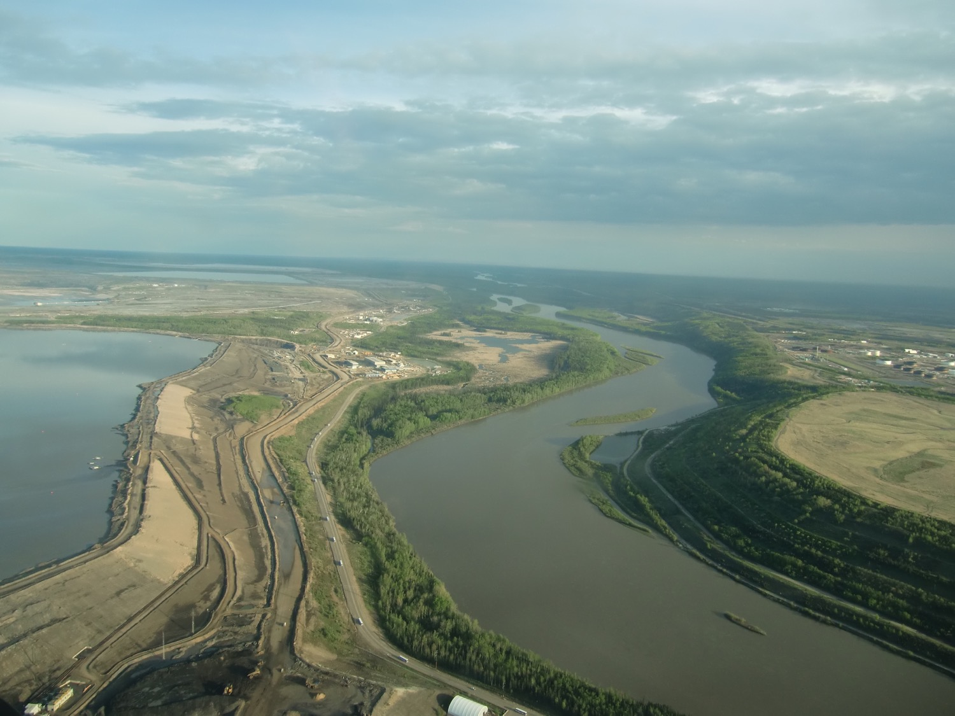
Dr. Tara Joly
(Anthropology)
SOCIAL ASPECTS OF OIL SANDS RECLAMATION
In northeastern Alberta, oil sands extraction has resulted in ongoing environmental contamination and decreases in biodiversity, resulting in a loss of land base for Indigenous communities in which to practice their rights and maintain spiritual connections. Alberta requires that all oil companies reclaim land disturbed by their extractive activities. Reclamation is defined in policy as a process of returning the land to a productive, or useful state – a state that can support commercial forestry, agriculture, ranching, recreation, or Indigenous land uses. My work traces how reclamation and extractivism can be seen as settler colonial processes of “making productive land” which seeks not only to gain control and wealth from the land, but also to remake the territory from Indigenous home into settler or extractive space.
ArcticNet Project Number 33: Using Co-Produced Knowledge to Understand and Manage Subsistence Marine Harvests in a Changing Climate

Slide 16
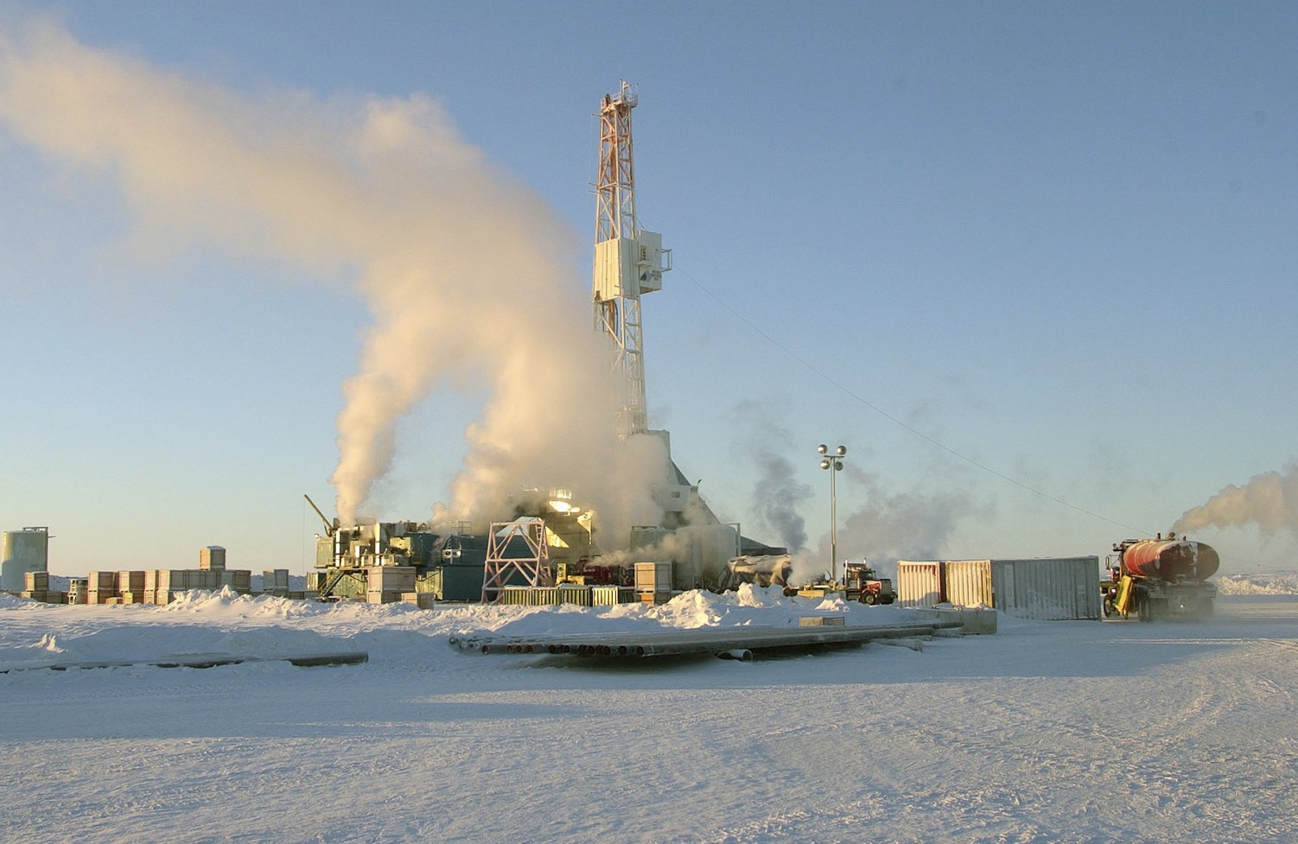
Sahtu and Métis Community Engagement in the Closure and Reclamation of the Norman Wells Oilfield
Aim: To examine the processes of engagement and roles of Sahtu Dene and Metis knowledge and perspectives for their traditional territory in the Norman Wells Oilfield Development and Pipeline Project.
Annie King
MA NRES
Getty Images

Slide 17
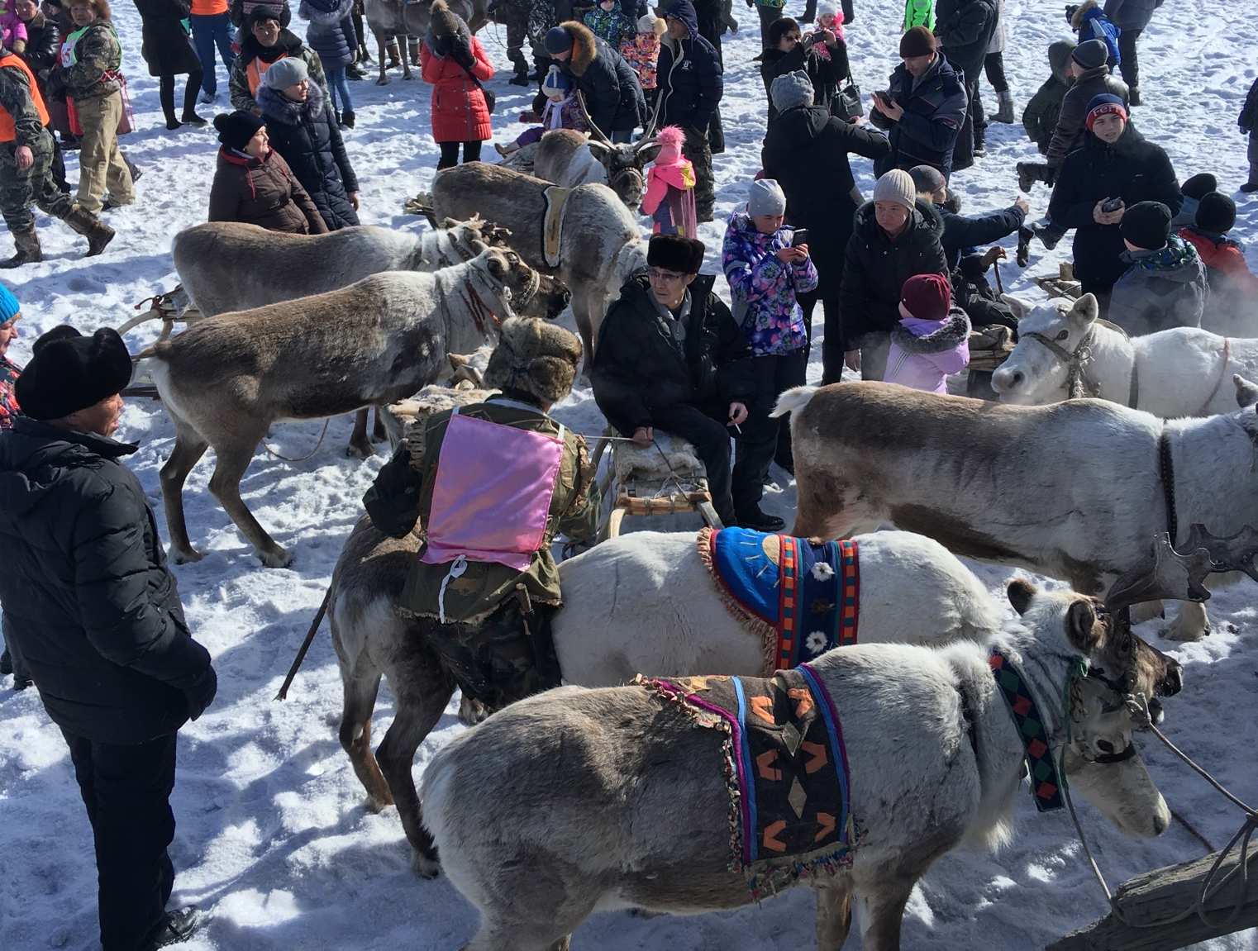
NORTHERN RESEARCH AT UNBC
CIRUCMPOLAR
NATURAL SCIENCE
INDIGENOUS
ARCTIC
HUMANITIES
INTERNATIONAL
NORTHERN STUDIES
SOCIAL SCIENCE
INTERDISCIPLINARY

Slide 18
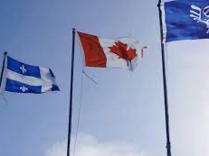
Photo: Nunatsiaq News
Dr. Gary Wilson, Dr. Gail Fondahl & Nicholas Parlato
(Political Science; Geography, Earth & Environmental Sciences; former MA IDIS graduate)
ETHNOFEDERALISM, REGIONAL SOVEREIGNTY AND INDIGENOUS SELF-DETERMINATION IN QUÉBEC AND THE SAKHA REPUBLIC (YAKUTIA)
Québec in Canada and Sakha Republic (Yakutia) (RS(Y)) in Russia both distinguish themselves as powerful jurisdictions within their respective federations, which offer political representation to a distinct ethnic group (Québécois and Sakha), while also serving as home to numerous Indigenous peoples. Have Indigenous peoples in Québec and RS(Y) found provincial and regional governments more supportive of their rights for greater self-determination compared to other constituent units within their respective federations? Support for Indigenous rights appears most developed n the very sub-federal units that have themselves pushed successfully for greater autonomy. We compare Indigenous-provincial/ regional relations in Québec and RS(Y), attending to how the broader struggles that these regions have with the federal government have influenced recognition, accommodation, and advancement of Indigenous interests.

Slide 19
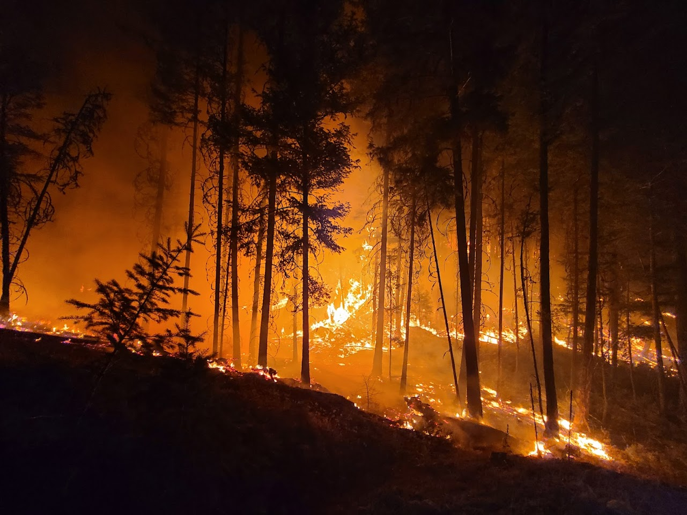
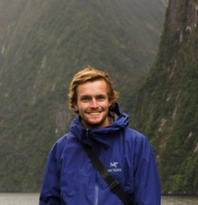
Assessing the Vulnerability of Northern Communities to Wildfire Risks
James Whitehead
MSc NRES
whiteheaj@unbc.ca
Climate change is accelerating the frequency of large fires in British Columbia and Canada’s North. My research seeks to find out the ways in which northern communities understand and are vulnerable to the risk of fire. This conception of vulnerability seeks to move beyond a purely biophysical definition and instead consider community level factors which impact how a wildfire is experienced by the community.

Slide 20
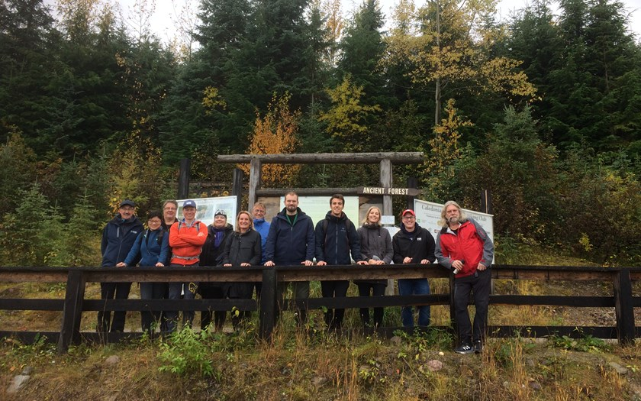
The focus of this thematic network is multilevel and comparative governance in the circumpolar north. The network facilitates collaboration between a diverse group of researchers from across the Circumpolar North who study the institutional evolution of Arctic and northern governance from the local to global levels. It encourages the comparative examination of governance across different political jurisdictions. The network organizes conference panels and workshops and welcomes research collaboration between academics and stakeholders that responds to regional and local needs.
https://www.uarctic.org/organization/thematic-networks/arctic-and-northern-governance/
University of the Arctic Thematic Network on Arctic and Northern Governance
Dr. Gary N. Wilson (Research Lead), Dr. Gail Fondahl (Member)

Slide 21
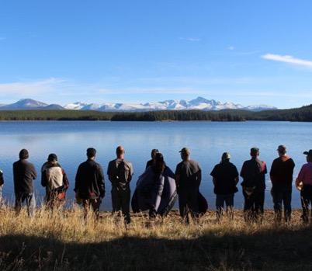
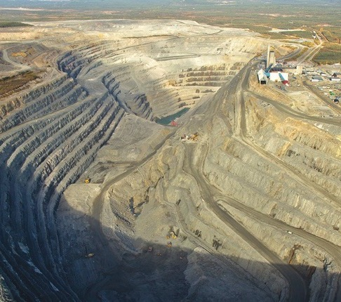
Drs. Paul Bowles, Fiona McPhail & Gary Wilson
(Global and International Studies, Economics, Political Science)
What’s in a Social License to Mine? Indigenous, Industry, and Government Best Practices for Social Innovation
Source: Tŝilhqot’in National Government
Source: Mining Weekly
Mining is economically important and politically contentious in circumpolar countries. This research compares mining projects in northern Sweden and Canada to understand the interplay between government, industry and Indigenous communities. We focuses on factors that support or inhibit the establishment of social license (community acceptance and buy-in). A key aim is to develop tools to manage Swedish land use conflicts involving the mining industry, Indigenous communities and the state by drawing on the Canadian experience. The project also compares social licensing and mine establishment across Swedish and Canadian jurisdictions to explore the role of regulatory frameworks and identify well-functioning practices in relation to Indigenous rights and land use. Partners include Luleå University of Technology in Sweden, University of Saskatchewan, UNBC, and a number of industries and communities. UNBC researchers focus on the the proposed Prosperity/New Prosperity copper/gold mine in BC.

