Slide 1
Managing Student Expectations for Online Learning

Slide 2
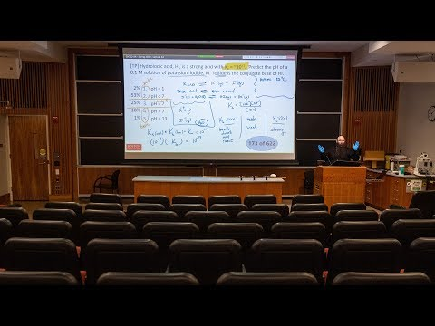
A quick film...

Slide 3
Establishing trust with dedicated online syllabi
Dedicated online syllabi can clarify:
Office hours
Assessment rubrics
Access to library resources
Synchronous delivery vs. Asynchronous delivery

Slide 4
‘Online office hours’
Discussion thread related to course assessments
Open ‘collaborate’ session at a designated time
Students and instructors benefit when e-mail is kept to a minimum Other ideas for creating online office hours?

Slide 5
Assessment rubrics
Rubrics for class participation are especially important, as expectations surrounding participation are vague without them
Using examples could aid in clarifying a rubric
Sharing is caring! Writing rubrics presents an opportunity for collaboration amongst instructors and students
What are the barriers to employing rubric best practices?

Slide 6
Access to Library Resources
How will library resources be utilized or accessed in the Fall?
Will the library be open with social distancing protocols in place ?
“On Reserve” items
Material request service “click and collect”
Access to UNBC archive materials
Bookstore - textbooks are listed and available from bookstore website

Slide 7
Synchronous delivery vs. Asynchronous delivery
Asynchronous
Recorded lectures should be shorter than in-person lectures
Consistency in discussion board moderation
Synchronous
Encourage students to share video
Explicit opportunities for interaction

Slide 8
Final thoughts...
How do you envision managing student expectations for online learning?
Notes:
6 pillars or learning plus Excellence

